Slide 1
Analytical CRM Development for a Bank
-R.Mohanakanna

Slide 2
Introduction
In today's competitive landscape, understanding customer behavior and preferences is paramount for sustained growth.
Analytical Customer Relationship Management (CRM) serves as a strategic tool for harnessing data insights to enhance customer engagement, satisfaction, and retention.
Gain a deeper understanding of customer needs and market trends, enabling proactive decision-making.
Drive incremental revenue through targeted cross-selling, up-selling, and retention strategies
Analytical CRM also plays a crucial role in risk management. By analyzing patterns and anomalies in transaction data, banks can proactively identify potential fraud and mitigate risks, safeguarding both the institution and its customers.

Slide 3
Objectives
To analyze behaviour patterns of long-term versus new customers to understand loyalty drivers.
Identify cross-selling opportunities by studying product affinity and usage correlations.
Correlate geographic economic indicators with account activity and churn rates for targeted strategies.
Assess demographic segments posing high financial risk to optimize risk management.
To Forecast customer lifetime value using predictive models based on tenure and transaction history.
To evaluate marketing campaign effectiveness and churn reasons to refine strategies and improve retention.

Slide 4
Data Overview
RowNumber: The row number in the dataset, likely used for reference or indexing.
CustomerId: A unique identifier for each customer.
CreditScore: A numerical representation of the customer's creditworthiness.
GeographyID: A numerical identifier that likely corresponds to a geographical location, such as a country or region.
GenderID: A numerical identifier for the customer's gender, where for example, '1' could represent male and '2' could represent female.
Bank DOJ: date when the Customer associated/joined with the bank.
Age: The age of the customer.

Slide 5
Data Overview Contd.
Tenure: The number of years the customer has been with the bank.
Balance: Current balance in the customer's account.
NumOfProducts: refers to the number of products that a customer has purchased through the bank.
HasCrCard: denotes whether or not a customer has a credit card. This column is also relevant, since people with a credit card are less likely to leave the bank.
IsActiveMember: active customers are less likely to leave the bank (as per the criteria defined by the bank for identifying the activeness).
Estimated Salary: as with balance, people with lower salaries are more likely to leave the bank compared to those with higher salaries.
Exited: whether or not the customer left the bank.

Slide 6
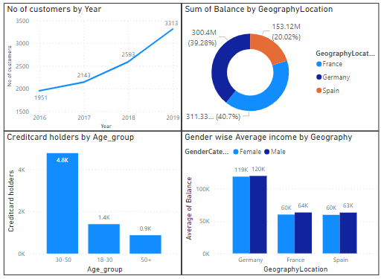
Analysis of Objective Questions
The number of customers joining year-wise increasing constantly
Among the countries Spain has lesser total balance indicates the lower customer satisfaction.
Customers in the age group of 30-50 can have high chance of holding creditcards.
Almost male and female have equal income in all the countries.
Figure:1

Slide 7
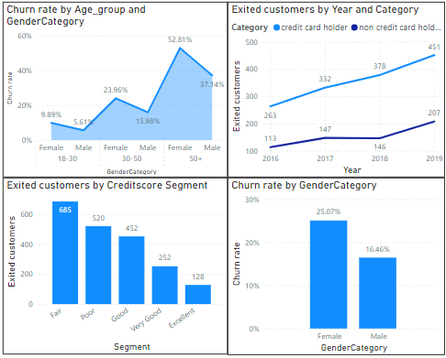
Analysis of Objective Questions Contd.
Females have higher churn rate then males.
Female customers in the age group 50+ have high churn rate
No. of Non credit card holders exited are less compared to credit card holders.
Customers in the Fair credit score segment has high chance of churn
Figure:2

Slide 8
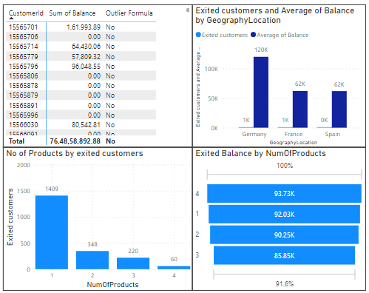
Analysis of Objective Questions Contd.
There are no outliers present in the given dataset
Exited customers mostly have balance in range of 60k-120k approximately in all the countries.
Customers those who purchase only one products are mostly exited.
Exited customers having high balance are purchasing either 1 or 4 products.
Figure:3

Slide 9
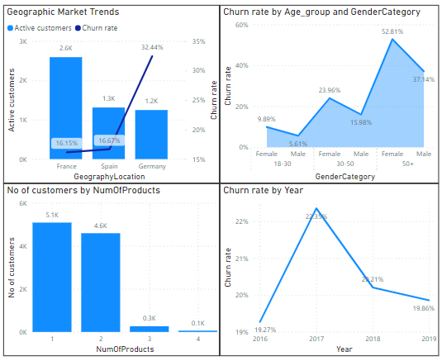
Geographic market trends and influence of demographic segements
Customers with the active status has lesser churn rate. And need economic indicators like unemployment rate etc… to correlate with the above factors.
Demographic segments like gender(female) and age group(50+) have high financial risk to the bank.
From the given data able to find how many products are commonly used and their cross selling strategies to find services require more data.
Churn rate gets reduced in the past 2 years and to find customer spending habits require expense data.
Figure:4

Slide 10
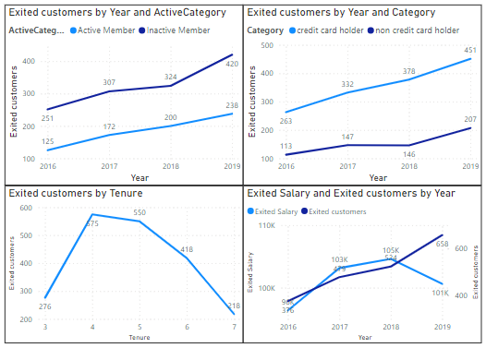
Customer Exit Reasons Exploration
Customers those who are active and non credit card holders have less chance of exit the bank.
Long-term customers with tenure greater than five years have less exit rate.
Customers those who exited have salary majorly in the range of 100-110k.

Slide 11
Marketing Campaign Effectiveness
To assess marketing campaign effectiveness on customer retention and acquisition, analyze metrics such as customer response rates, conversion rates, and churn rates before and after campaigns.
To enhance analysis, gather data on campaign specifics (e.g., target audience, channels), customer feedback, and external factors (e.g., competitor activity, economic conditions).
Utilize advanced analytics techniques like A/B testing and attribution modeling to attribute changes in customer behavior to specific campaigns accurately.

Slide 12
Strategic Recommendation to decrease churn rate
Enhance Customer Experience:
Improve the overall customer experience by providing exceptional service, personalized interactions, and timely resolution of issues.
Provide relevant offers, promotions, and content to maintain customer interest and loyalty.
Retention Offers:
Offer incentives or retention offers to encourage customers to stay with the bank.
Tailor offers based on customer segmentation and predictive analytics to maximize effectiveness.
Customer Segmentation:
Segment customers based on their needs, preferences, and behavior to tailor retention strategies effectively.
Identify high-value customers and those at risk of churn to prioritize retention efforts

Slide 13
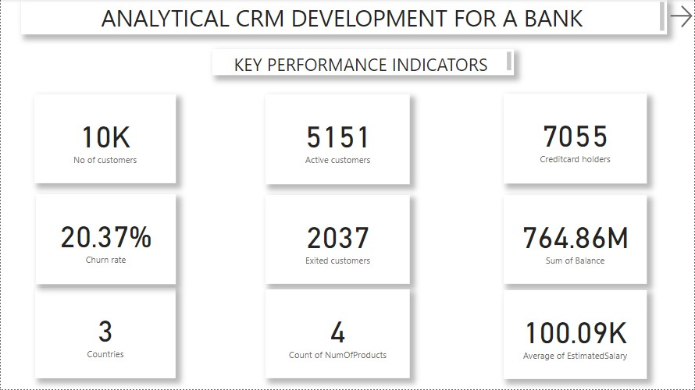
Main Tab

Slide 14
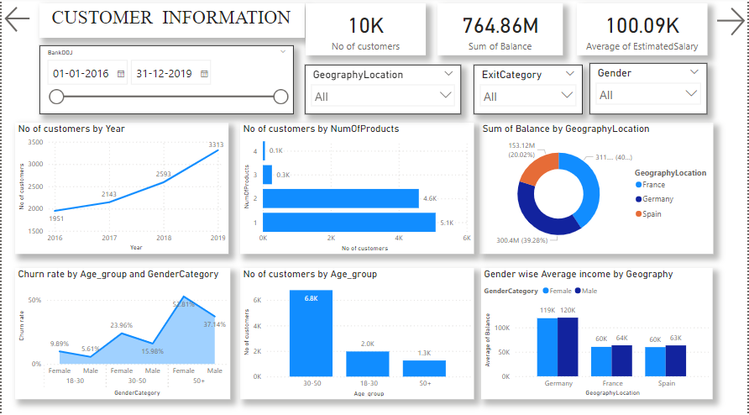
Customer Information Tab

Slide 15
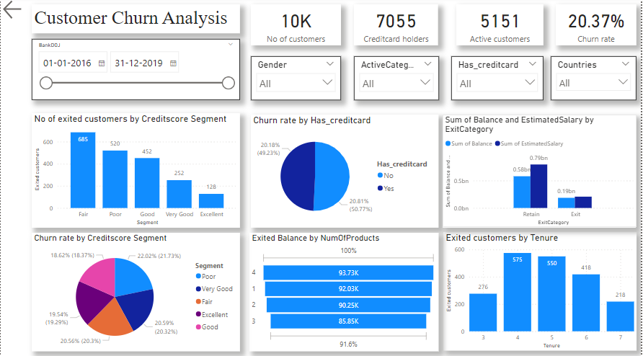
Customer Churn Analysis Tab

Slide 16
Conclusion
In conclusion, reducing churn rate is essential for sustaining long-term growth and profitability in the banking industry.
By prioritizing customer experience, implementing targeted communication, and offering proactive support, banks can enhance customer loyalty and retention.
Additionally, leveraging data analytics, innovative products, and personalized solutions can further strengthen customer relationships and mitigate churn risk.
Continuous monitoring, feedback integration, and adaptation of strategies based on customer insights are crucial for achieving sustained success in retaining customers and fostering enduring loyalty

Slide 17
References
CRM project

